Slide 1

PepersDev.Co - A Food Booking Website
By:- Divyaansh
03514802718

Slide 2
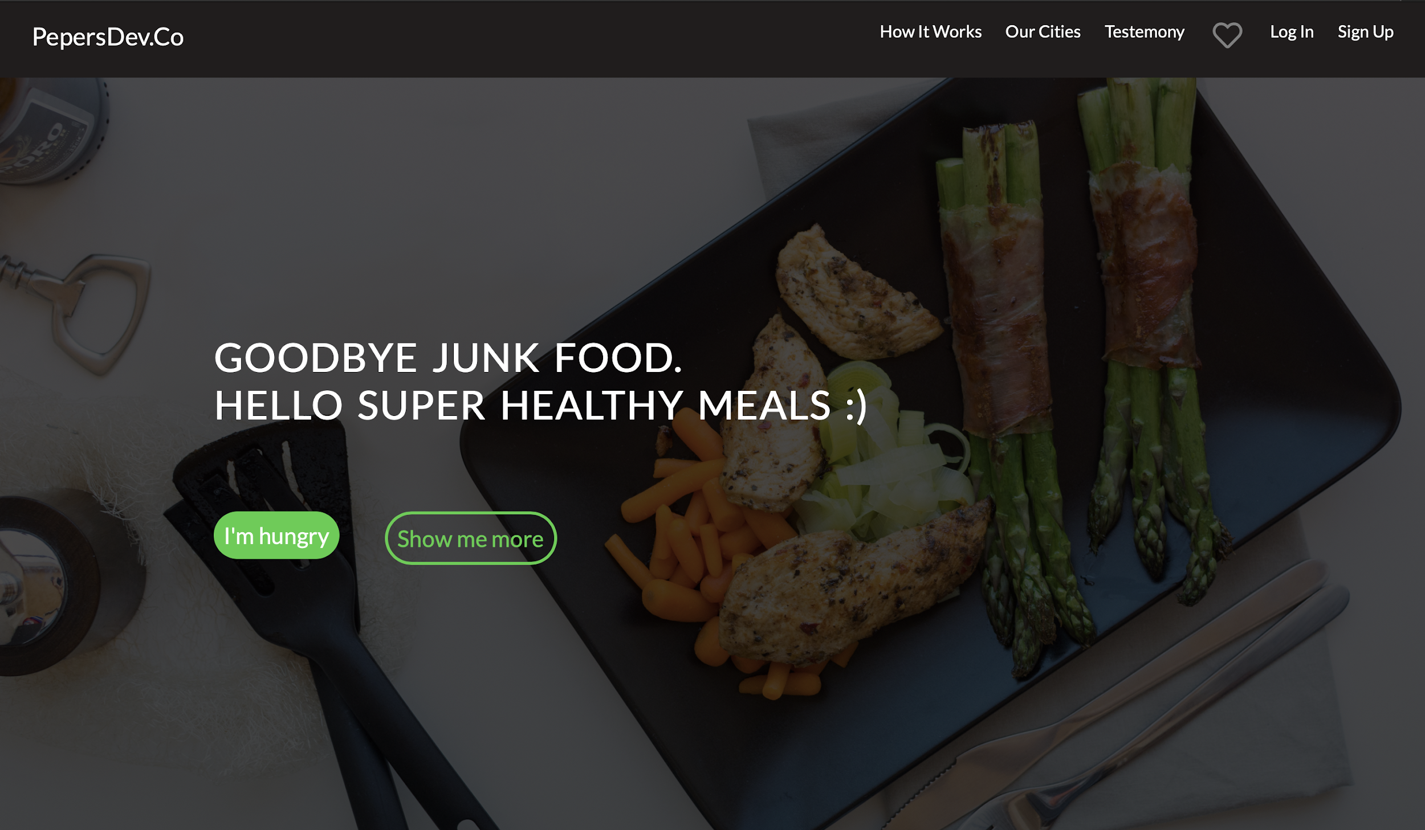
What it is all about ?
PepersDev.Co, A Food Booking Website allows both users and web app admin to optimize and secure their day to day tasks.
The website increases transparency and reduces the dependency on manual entries. This enables users to have greater control over their purchases. Also, this keeps the admin accountable to people because everything is stored in a cloud database.

Slide 3
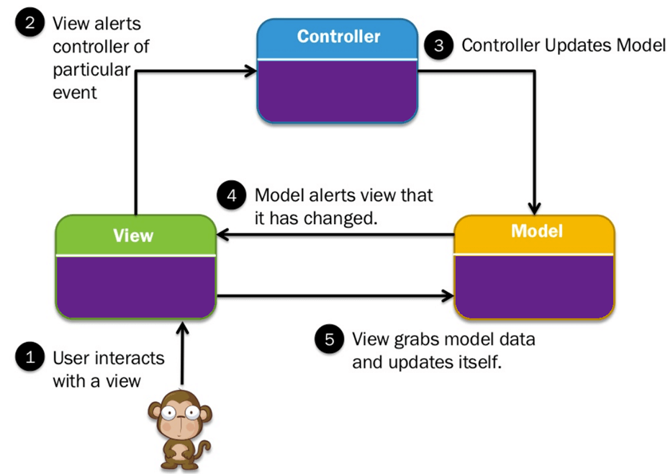
Behind the WebApp
Our application follows the traditional Model-View-Controller where we use:
Controllers to handle user requests and retrieve data.
Models to interact with your database and retrieve your objects’ information.
Views to render the page.
Additionally, routes are used to map URLs to designated controller actions, as shown in the image.

Slide 4
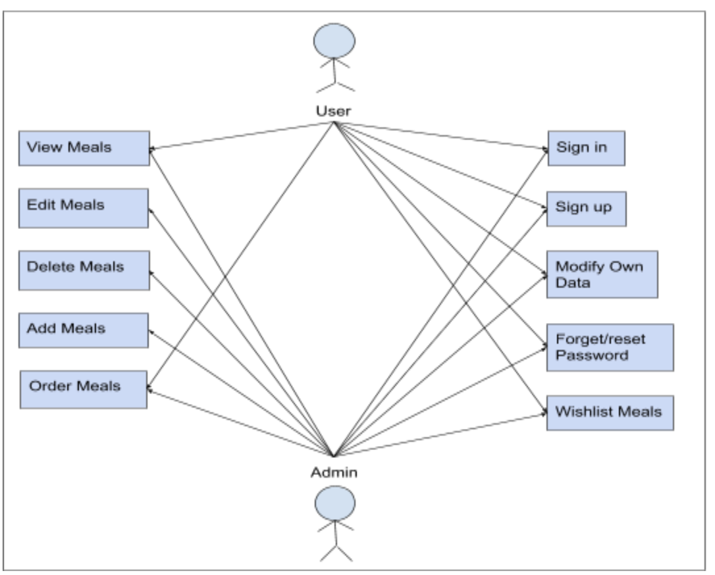
The Use Case
Use Case diagrams are used to identify the primary elements and processes that form the system.
The representation of this project is given adjacent, where one can see a schematic view of the interaction-thread model between as a user and as an admin. This follows a 2-tier relationship concept.

Slide 5

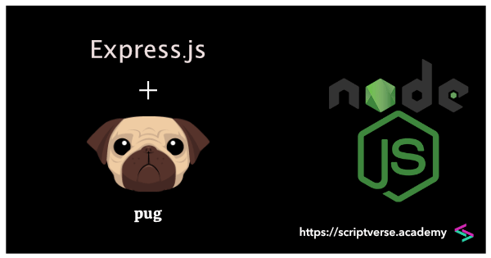
The Technology tools
This Tech Stack used in this project includes:-
Pug js , HTML , CSS for frontend ,
Node js for backend,
Express js for creating servers.
For storing data, it uses MongoDB.

Slide 6


1. HTML
Hypertext Markup Language (HTML) is the standard markup language for documents designed to be displayed in a web browser. It can be assisted by technologies such as Cascading Style Sheet (CSS) and scripting languages such as Javascript. Web browsers receive HTML documents from a web server or from local storage and render the documents into multimedia web pages. HTML describes the structure of a web page semantically and originally included cues for the appearance of the document.
HTML

Slide 7
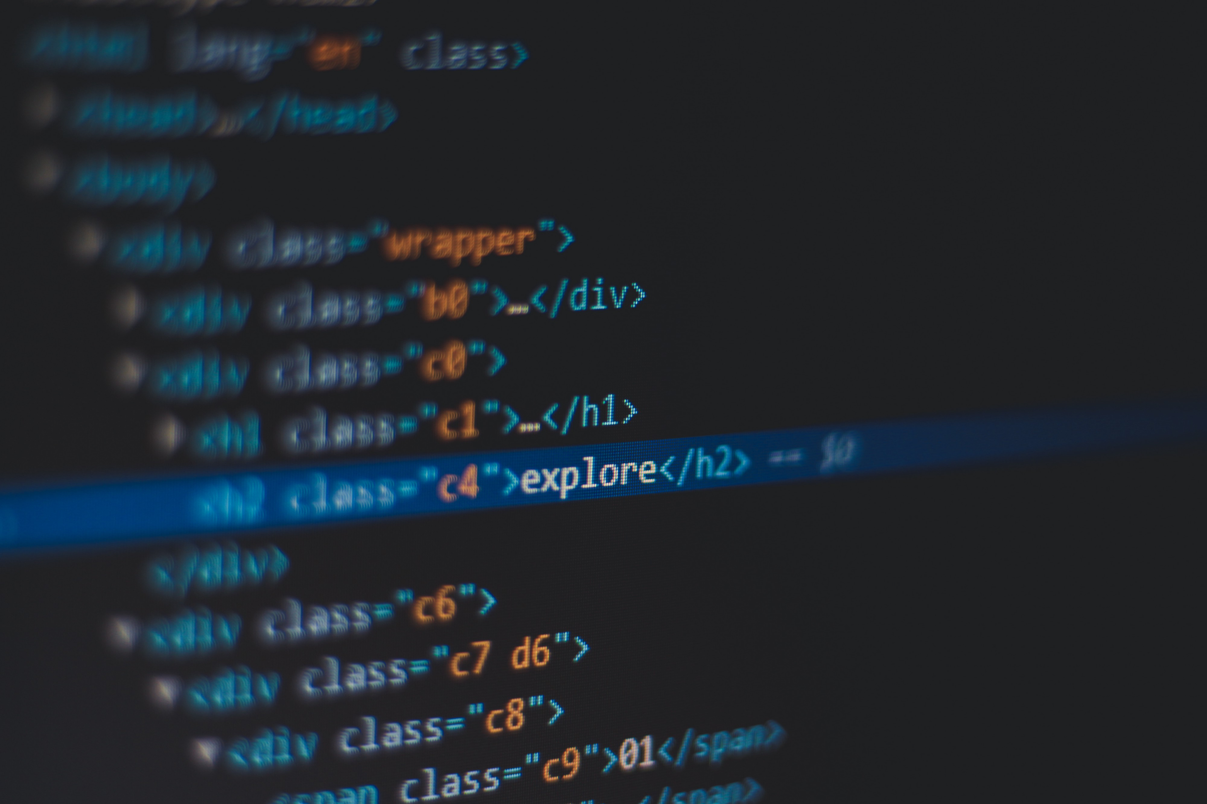

2. CSS
CSS
Cascading Style Sheets (CSS) is a style sheet language used for describing the presentation of a document written in a markup language like HTML. CSS is a cornerstone technology of the World Wide Web, alongside HTML and JavaScript.
CSS is designed to enable the separation of presentation and content, including layout, colors, and fonts.

Slide 8

3. PUG.JS
Pug.js is a HTML templating engine, which means you can write much simpler Pug code, which Pug compiler will compile into HTML code, that browser can understand.
Pug has powerful features like conditions, loops, includes, mixins using which we can render HTML code based on user input or reference data. Pug also support JavaScript natively, hence using JavaScript expressions, we can format HTML code.

Slide 9
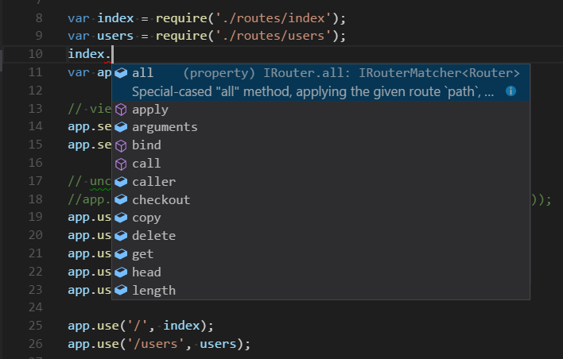

4. NODE.JS
Node.js is an open-source, cross-platform, JavaScript runtime environment (Framework) that executes JavaScript code outside a web browser. Node.js lets developers use JavaScript to write command line tools and for server-side scripting—running scripts server-side to produce dynamic web page content before the page is sent to the user's web browser. Consequently, Node.js represents a "JavaScript everywhere" paradigm,unifying web-application development around a single programming language, rather than different languages for server- and client-side scripts.

Slide 10

5. EXPRESS
Express is the most popular Node web framework, and is the underlying library for a number of other popular Node web frameworks. It provides mechanisms to:
Write handlers for requests with different HTTP verbs at different URL paths (routes).
Integrate with "view" rendering engines in order to generate responses by inserting data into templates.
Add additional request processing "middleware" at any point within the request handling pipeline

Slide 11

6. MONGODB
MongoDB is a cross-platform document-oriented database program. Classified as a NoSQL database program, MongoDB uses JSON-like documents with optional schemas. MongoDB is developed by MongoDB Inc. and licensed under the Server Side Public License (SSPL).

Slide 12
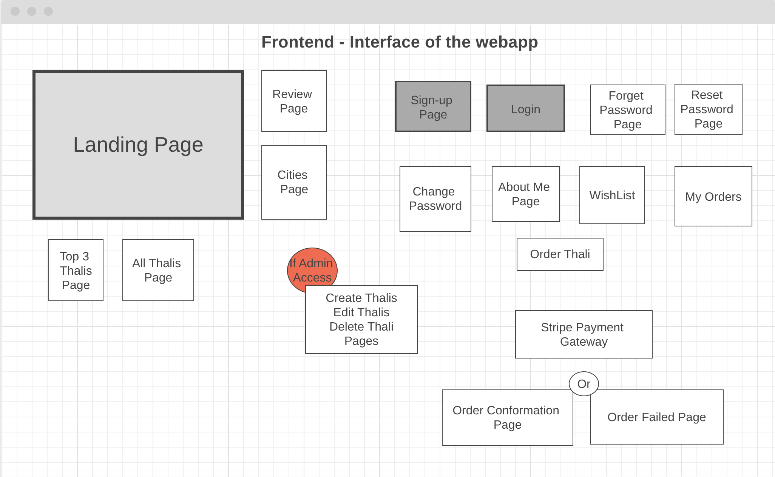
IMPLEMENTATION

Slide 13
SNAPSHOTS

Slide 14
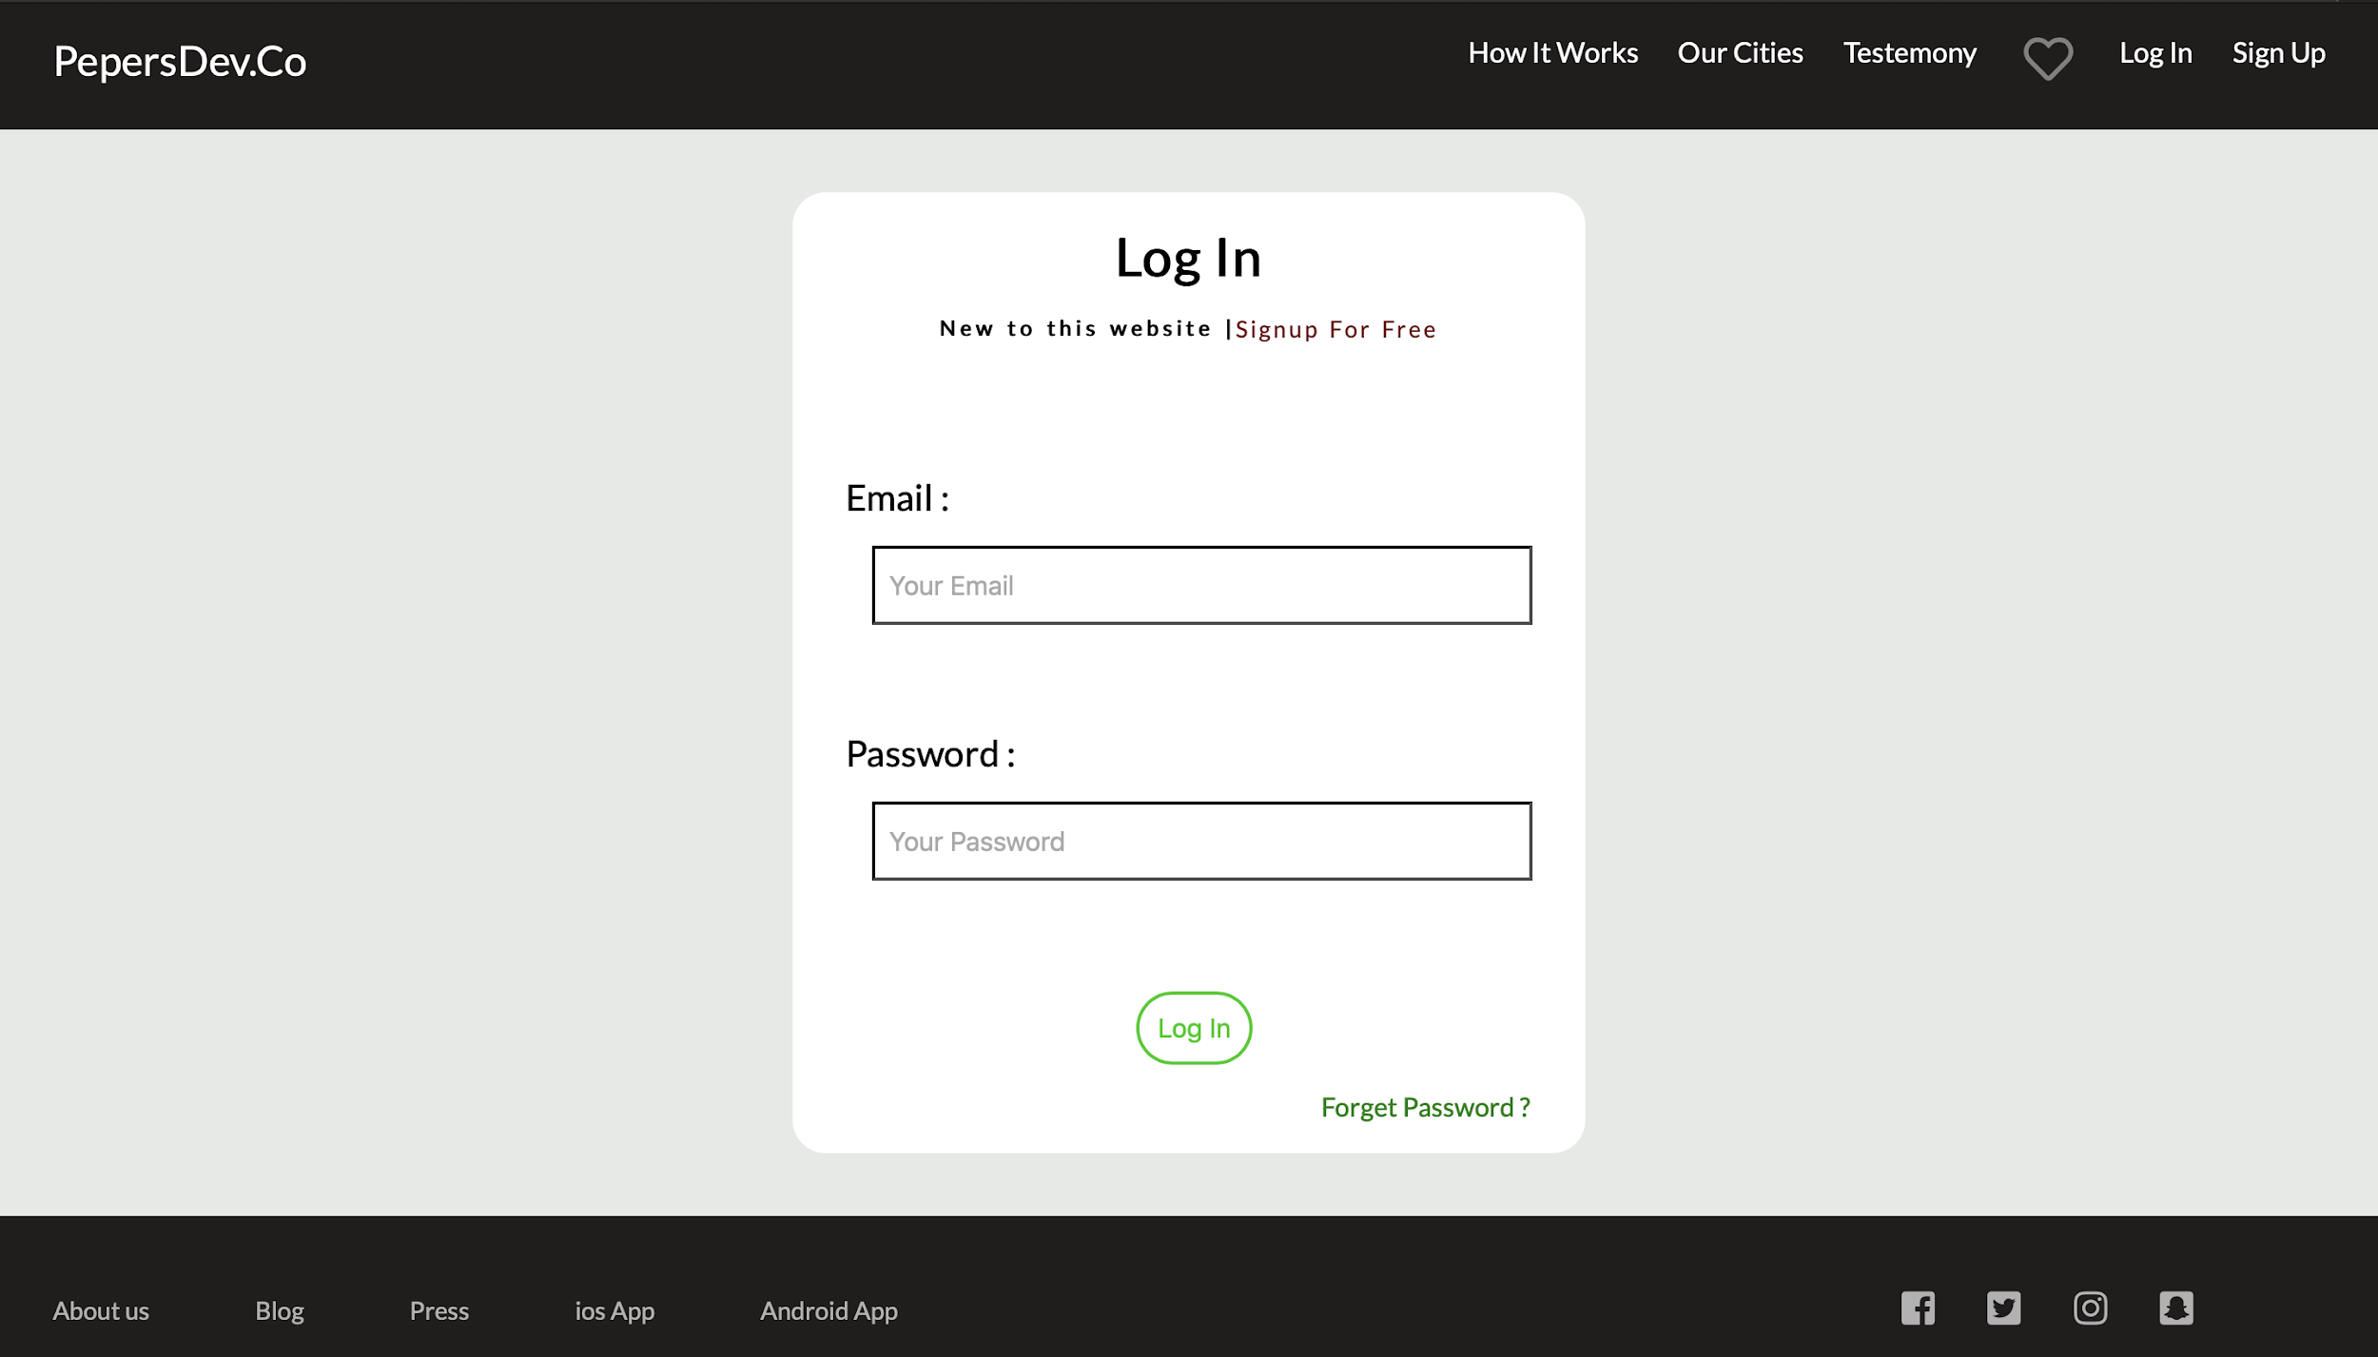
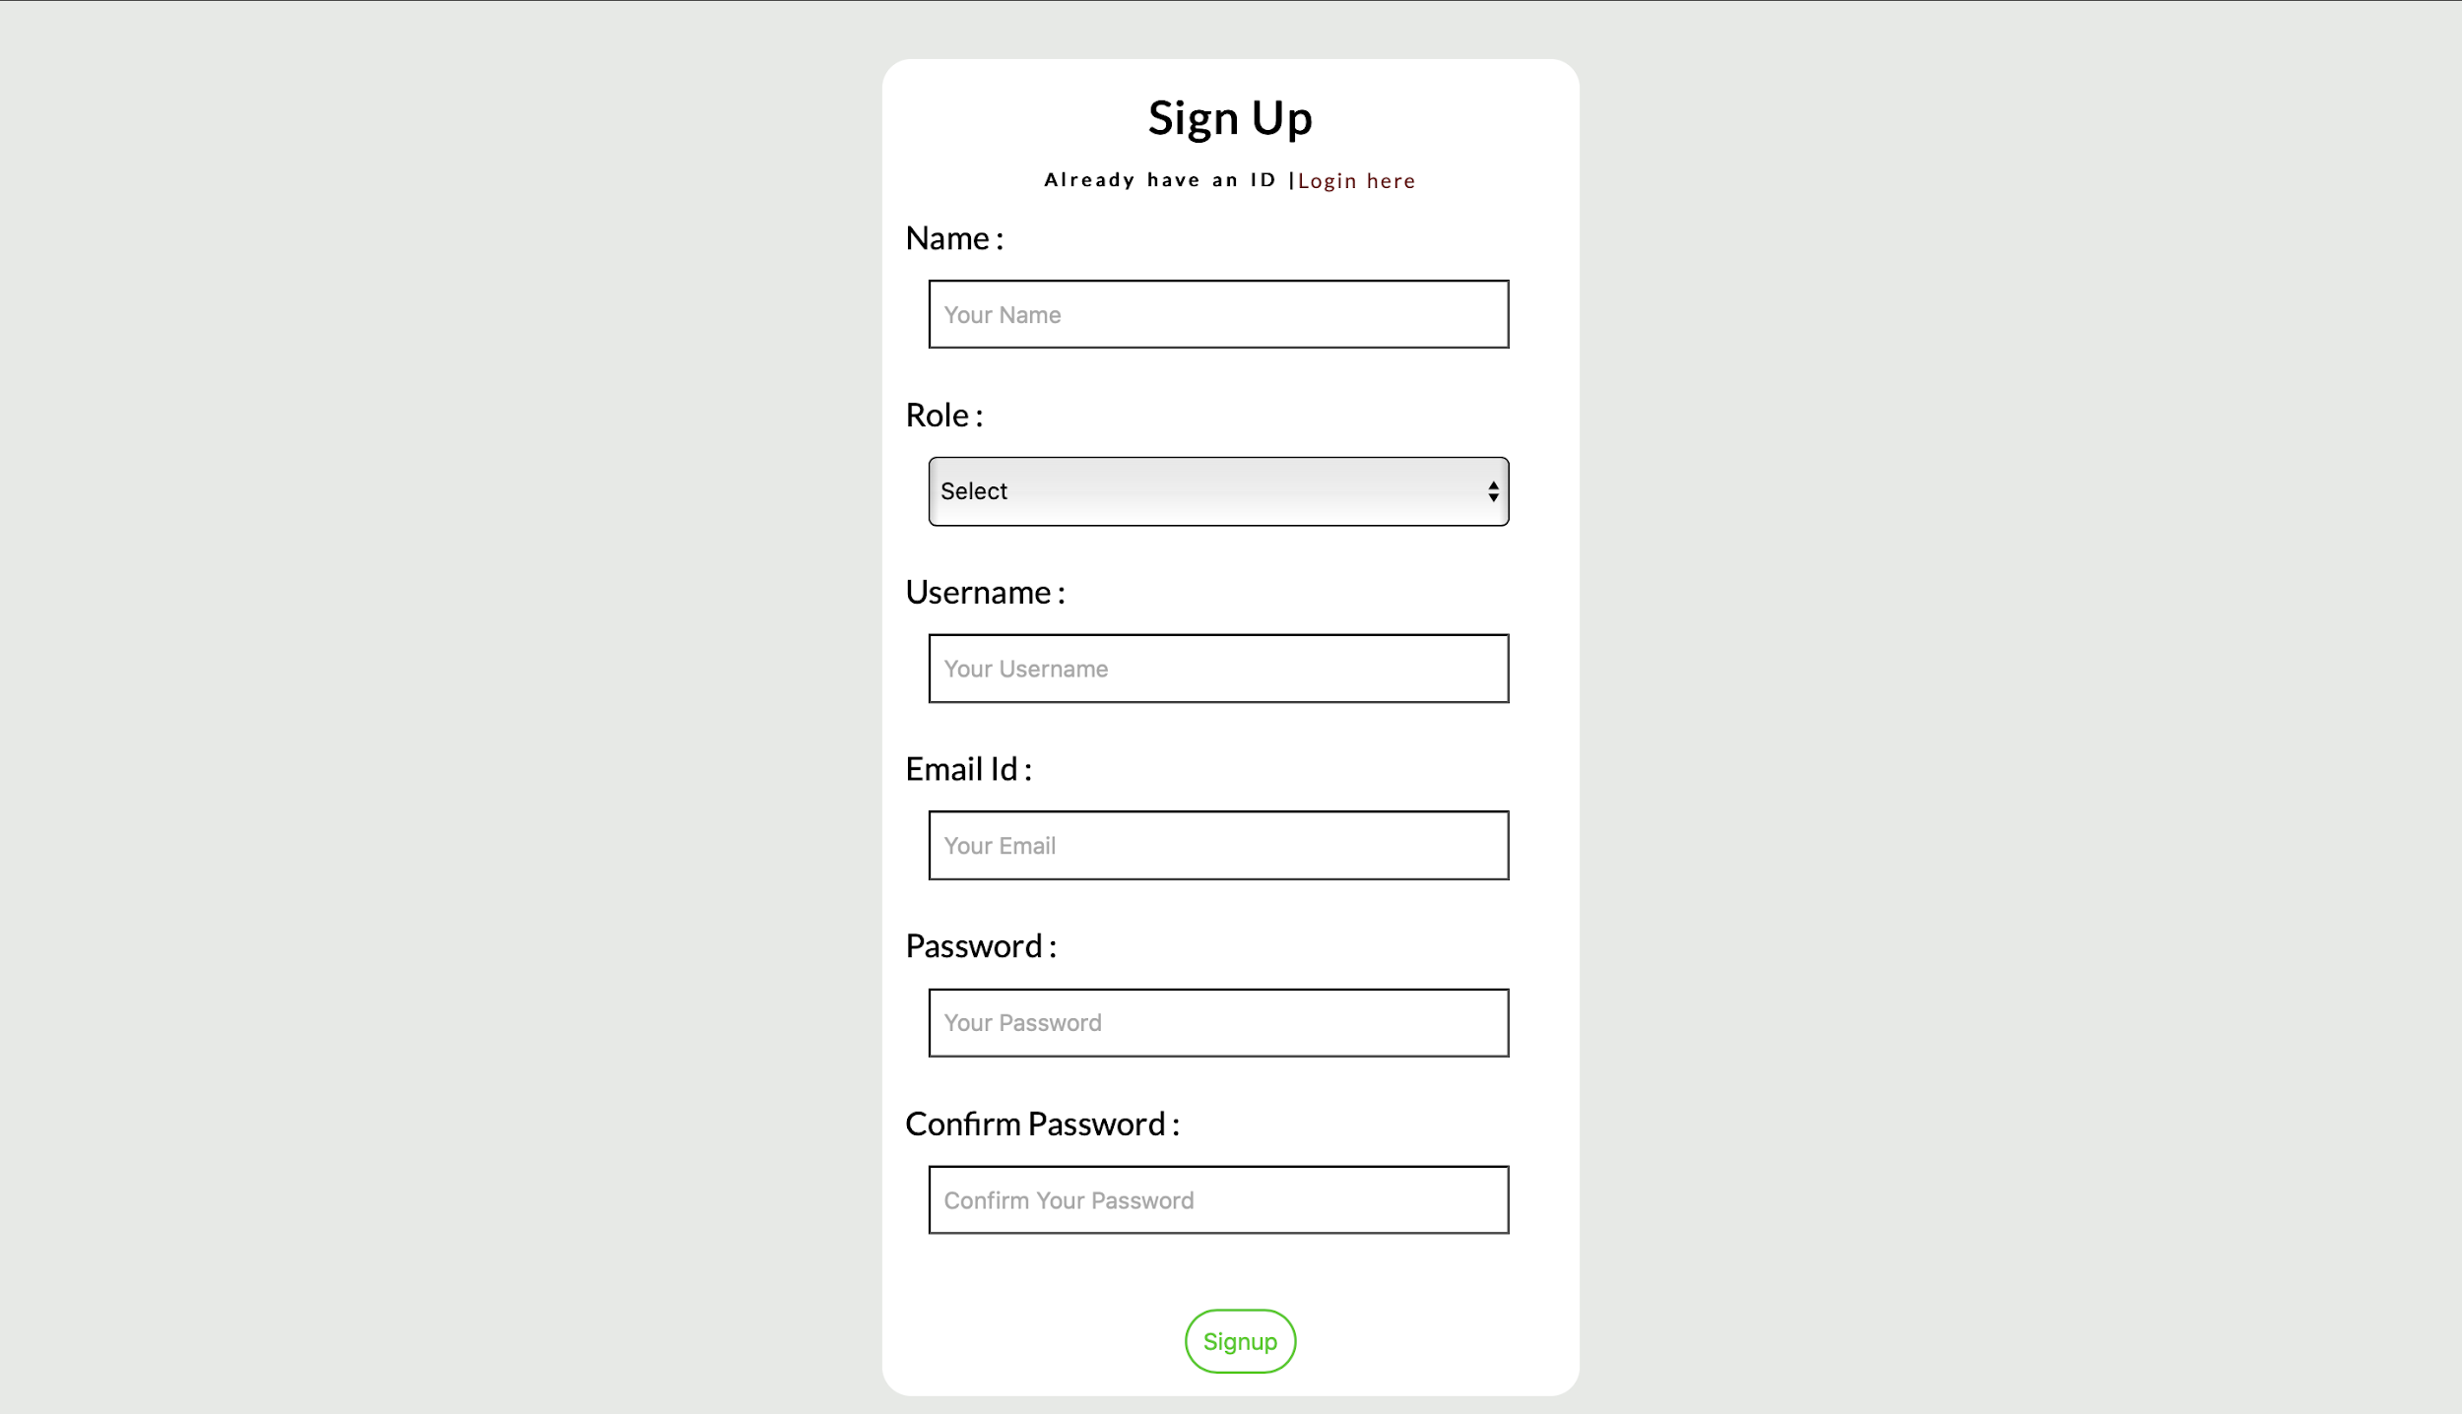
Implementation - SignUp and LogIn Pages

Slide 15
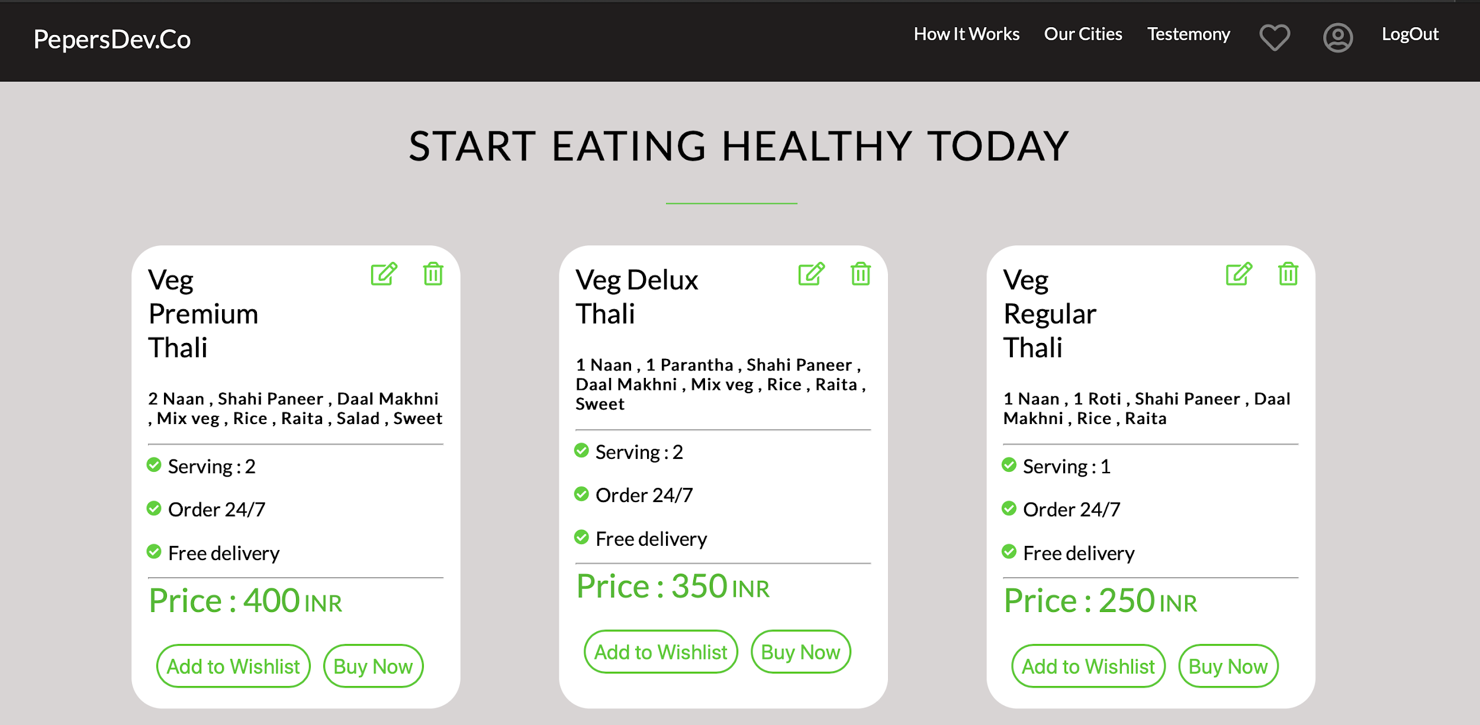
Implementation :
Plan Page

Slide 16
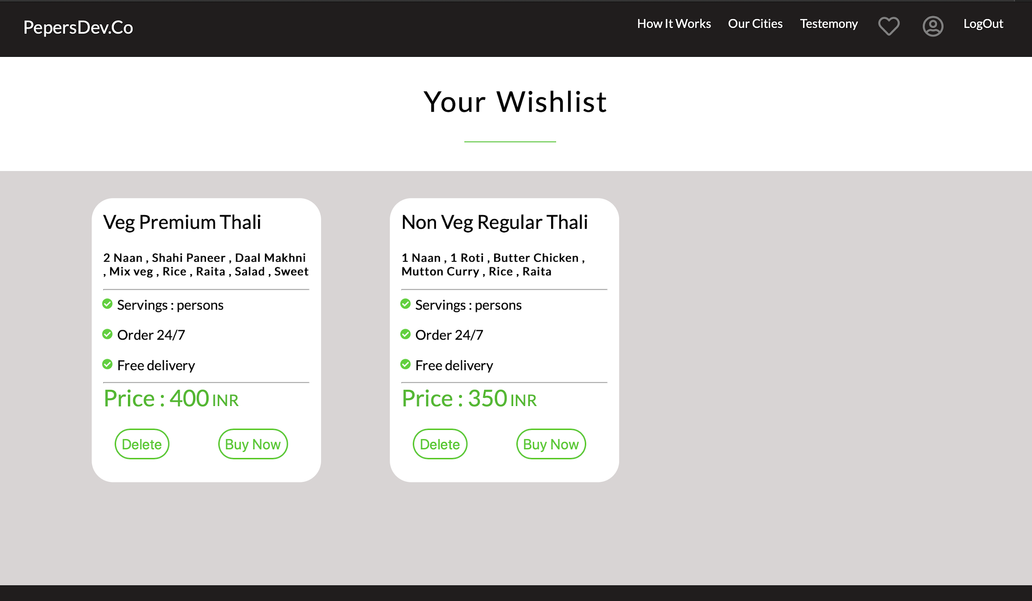
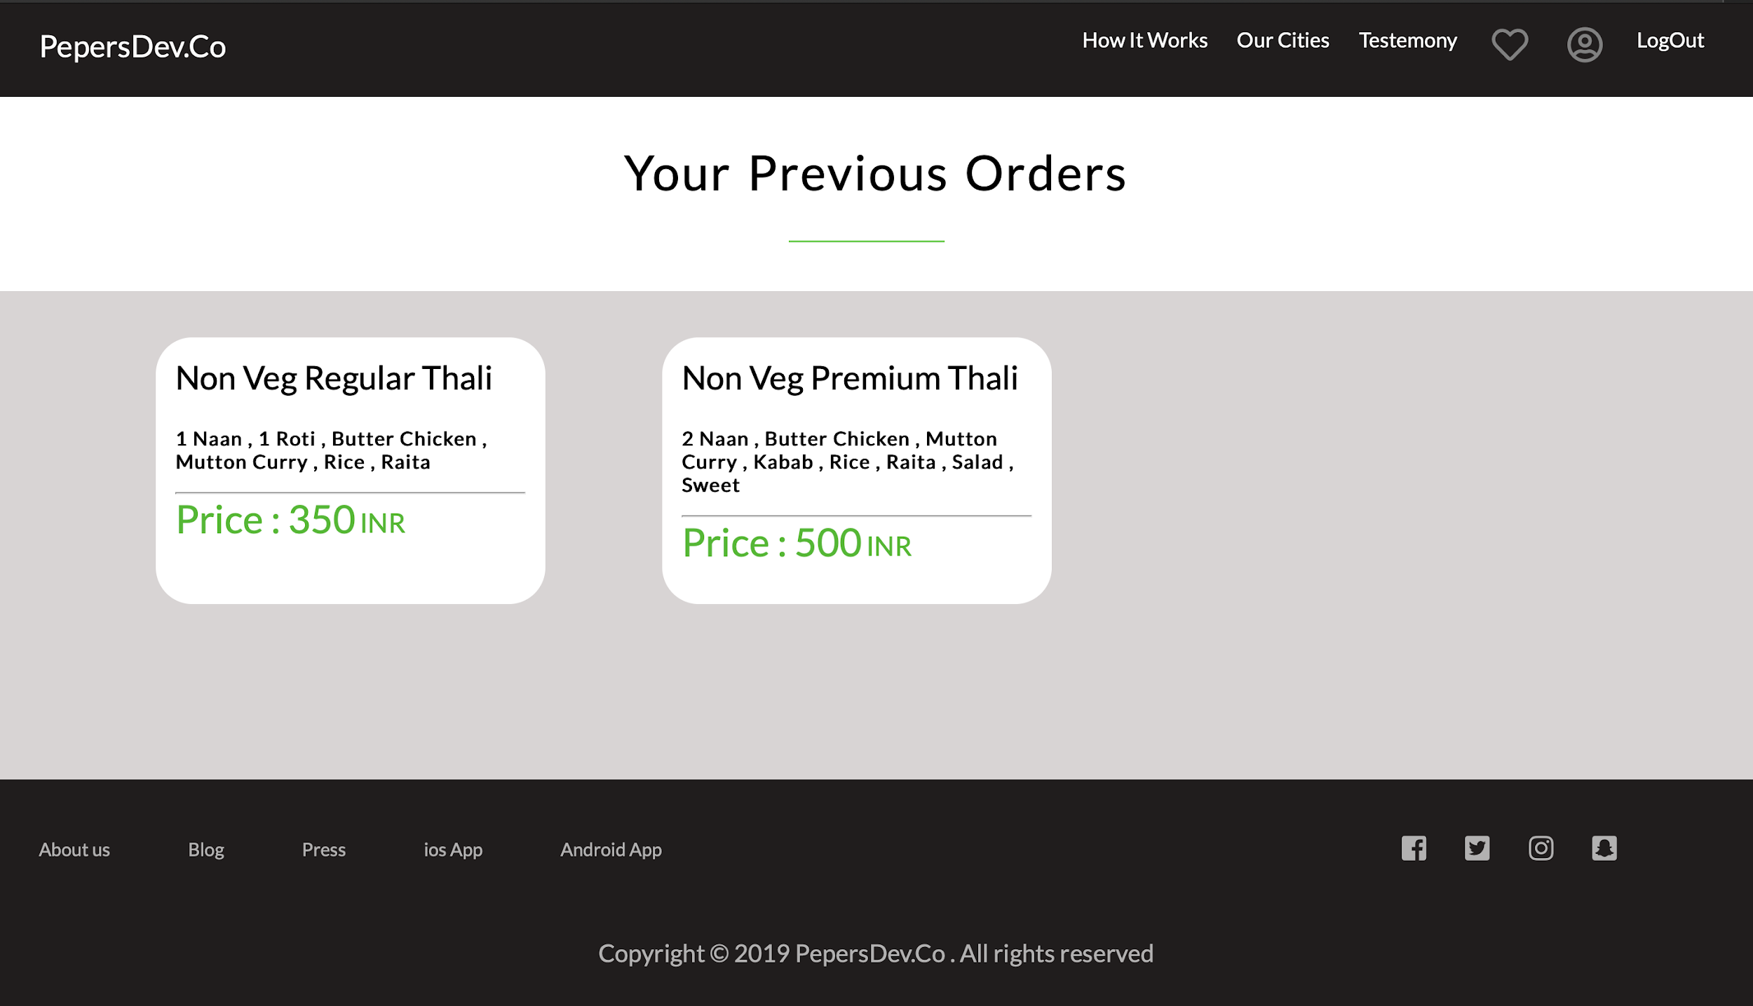
Implementation:
Previous Orders and Wishlist

Slide 17
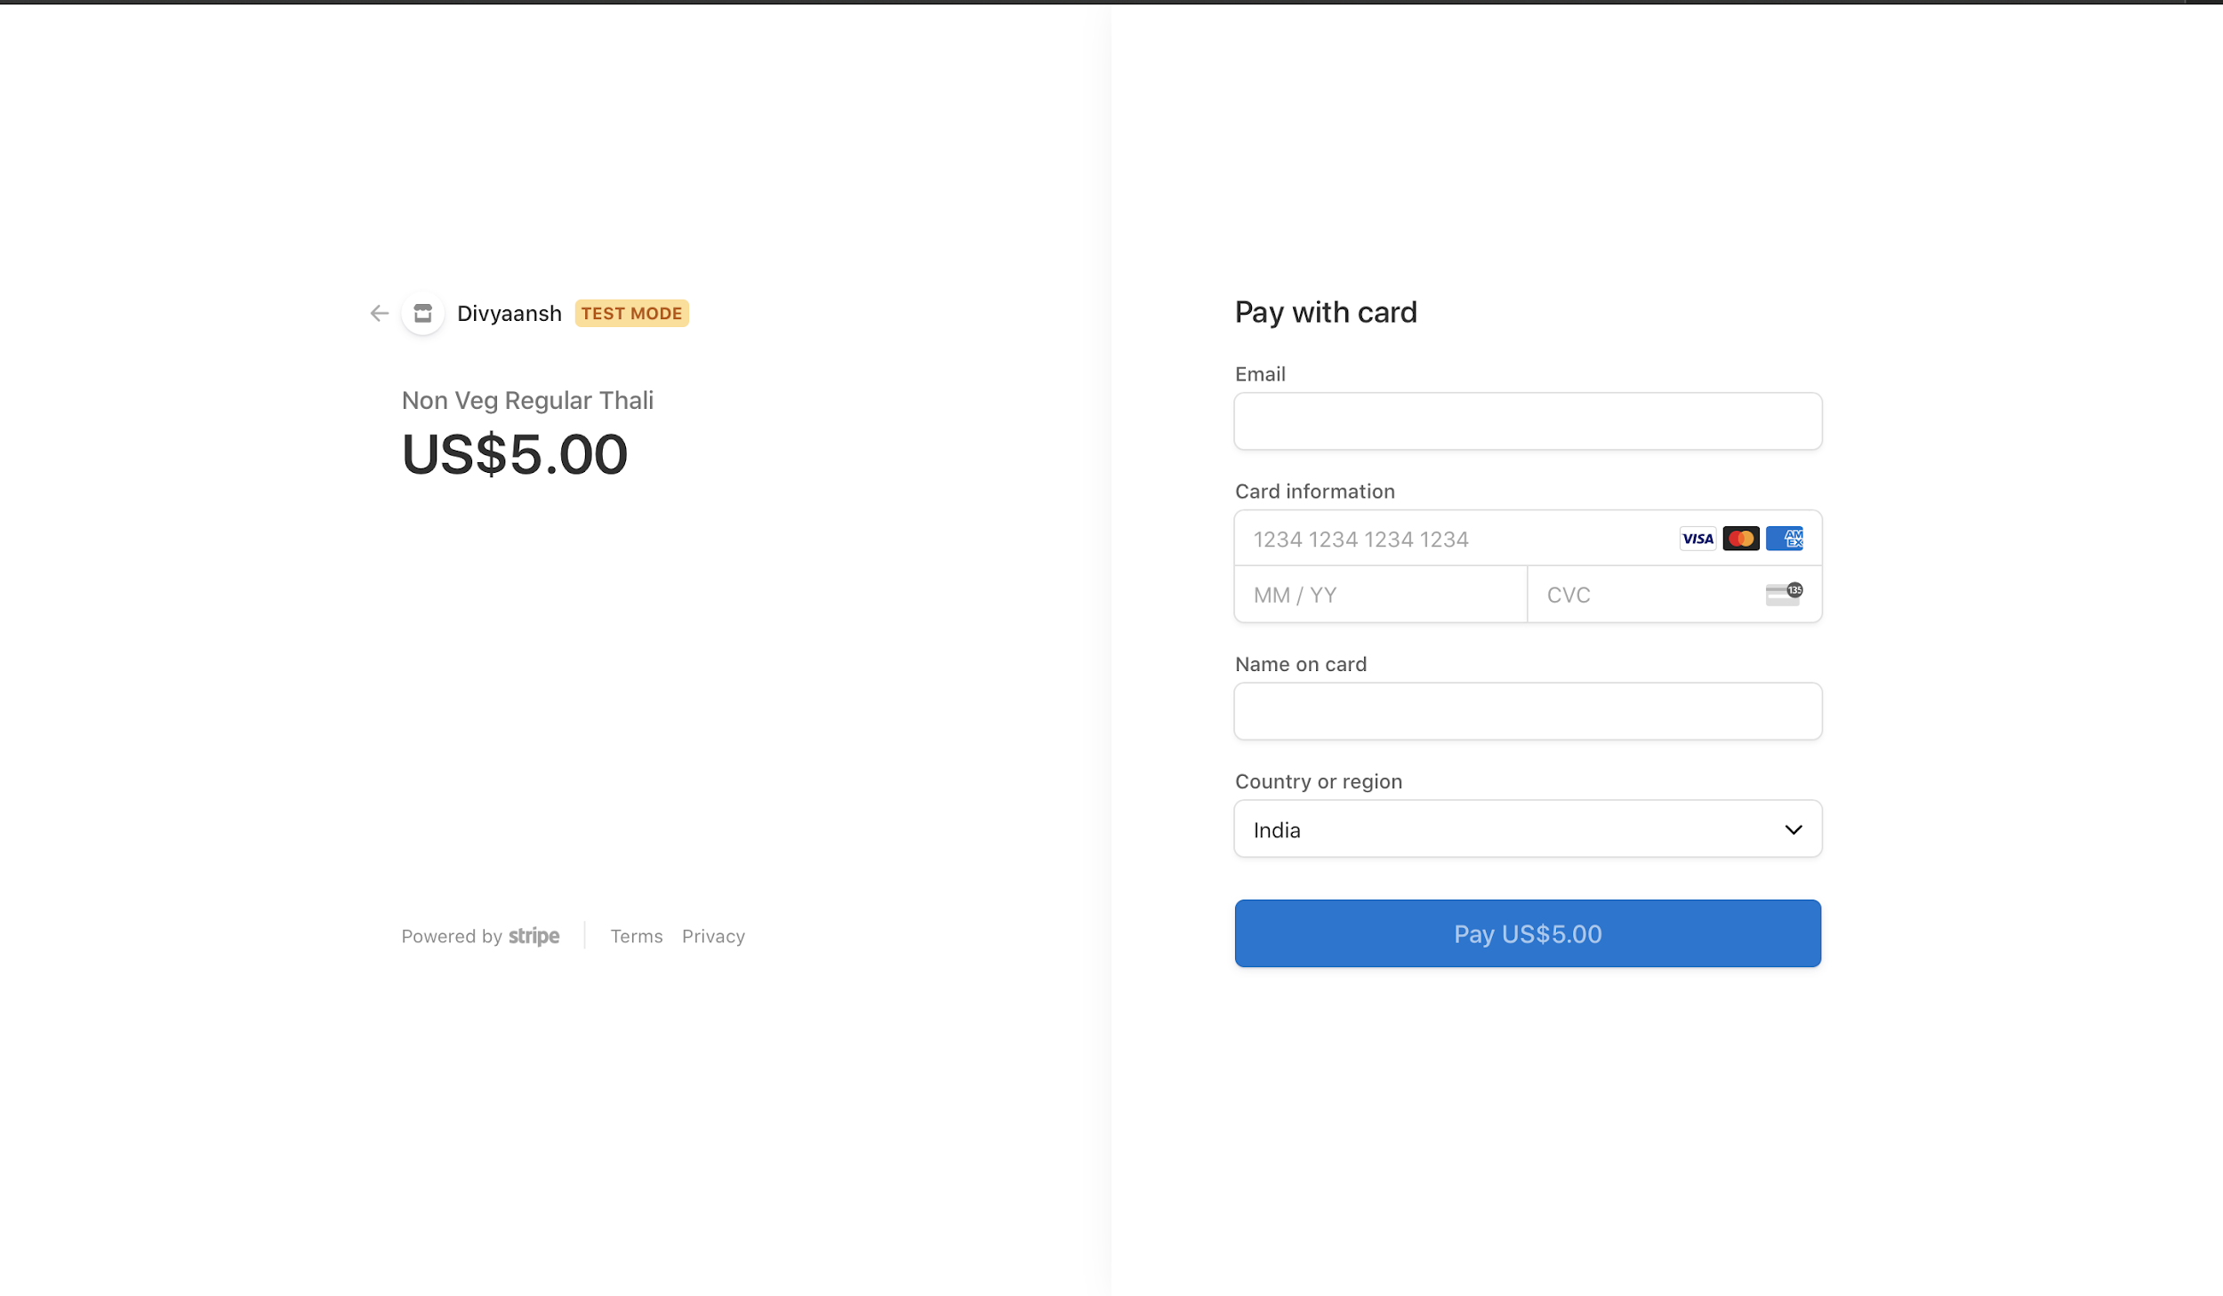
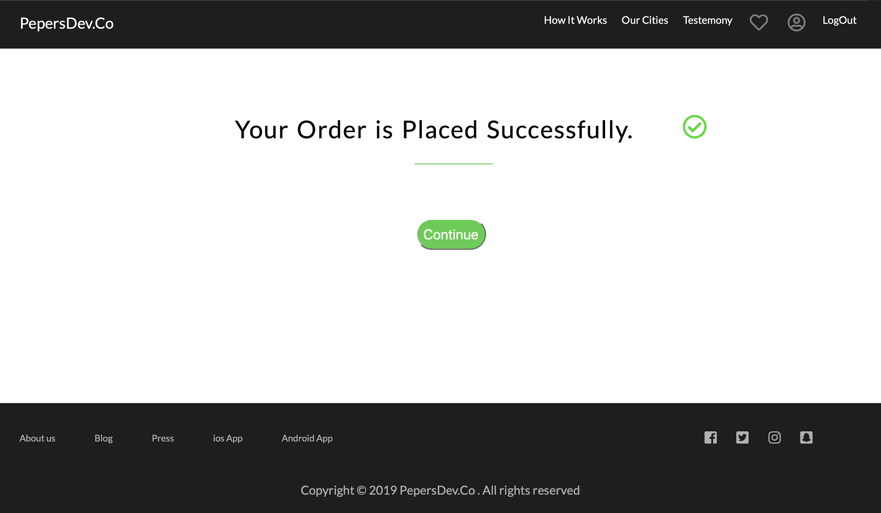
Stripe Payment Page
Payment Successful Page

Slide 18
THANK YOU

